Slide 1
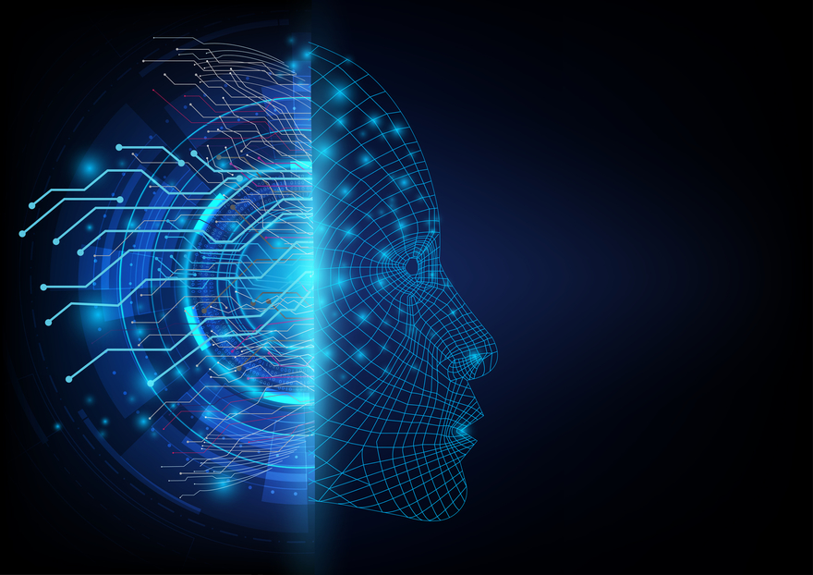
Machine
Learning
Henrique Padovani

Slide 2

Who
am I?

Slide 3
< ENG. PHYSICS @ UFRGS >
< ROTATION INTERN @ SAP >

Slide 4


Slide 5
< SAP >
< ROTATION PROGRAM >
< INTERVIEW TIPS & TRICKS >
< MACHINE LEARNING >

Slide 6

< SAP >
< ROTATION PROGRAM >
< INTERVIEW TIPS & TRICKS >
< MACHINE LEARNING >

Slide 7

< SAP >
< ROTATION PROGRAM >
< INTERVIEW TIPS & TRICKS >
< MACHINE LEARNING >

Slide 8


Slide 9
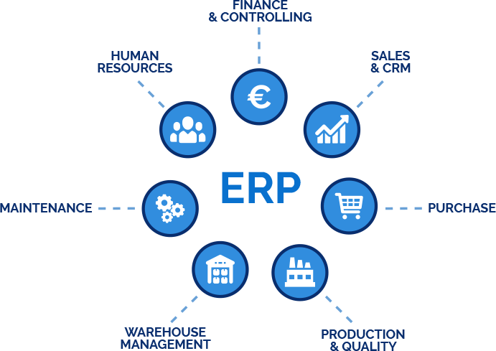
Notes:
Empresa alemã, que começou vendendo ERP para empresas. Atualmente ela vende ERP para as maiores empresas do mercado.
Ela é uma empresa global, tem sede em praticamente todos os países do mundo.
Aqui em São Leopoldo tem um LaB’s, em que o ambiente é voltado para criatividade.
Hoje os produtos da SAP vão muito além de ERP

Slide 10
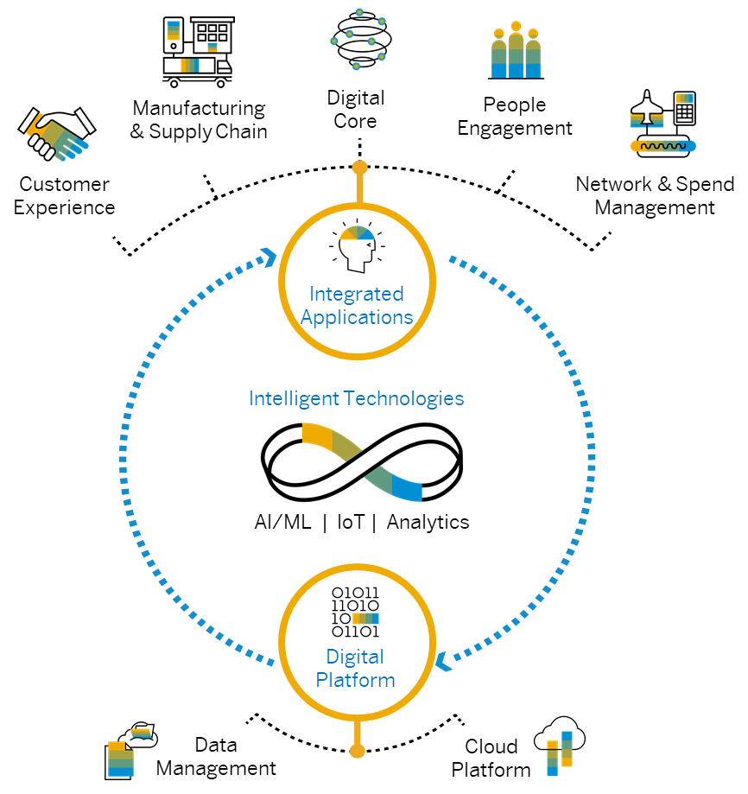

Slide 11

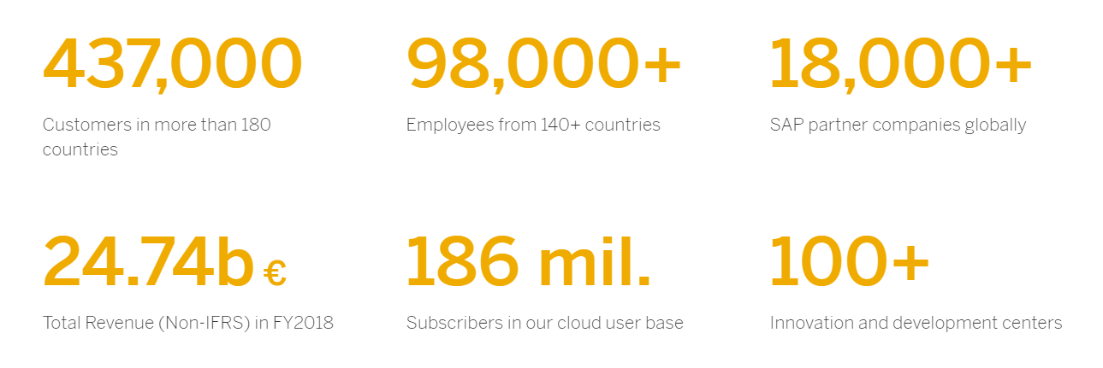

Slide 12

< SAP >
< ROTATION PROGRAM >
< INTERVIEW TIPS & TRICKS >
< MACHINE LEARNING >

Slide 13
ROTATION PROGRAM 2020
< 2 years >
< Three different areas – 8 month each >
< 32 Interns >
< Software Development - Technical Support - Business Support - Consulting >
< March 2020 >

Slide 14
< DEVELOPMENT >
< SUPPORT >
< MARKETING >
< human resources >
< EVENTS >
< CLIENTS >
< P.O.C. & PROTOTYPES >

Slide 15
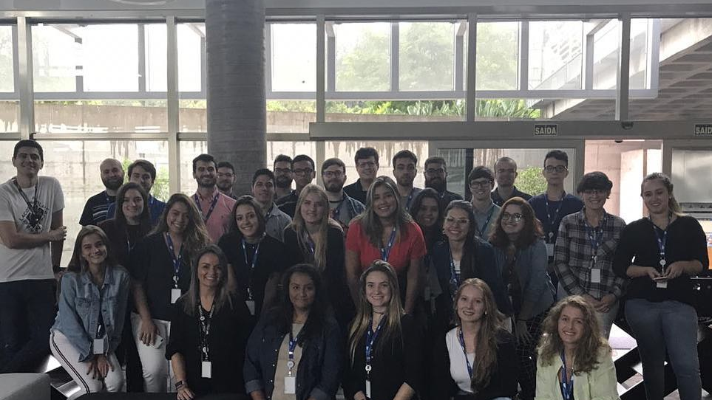

Slide 16
< SAP >
< ROTATION PROGRAM >
< INTERVIEW TIPS & TRICKS >
< MACHINE LEARNING >

Slide 17


Slide 18
DICAS DE ENTREVISTA DE PROGRAMAÇÃO
Lógica de programação
Orientação a objetos: Encapsulamento, herança, polimorfismo, interface. (Java)
Estrutura de dados: Lista Encadeada, Fila, Pilha, Árvore, Grafo.
Complexidade de tempo e de espaço.
Desafios de programação. (Python)
Banco de dados

Slide 19
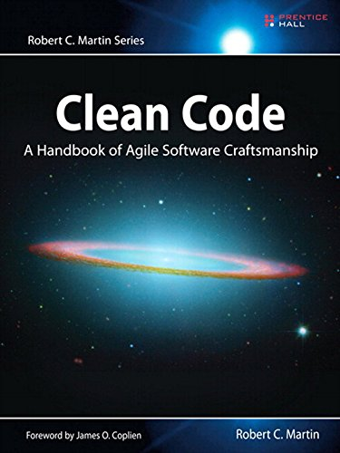
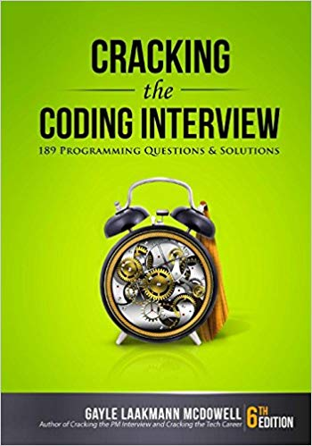
LIVROS
Clean code
Cracking the Coding Interview

Slide 20
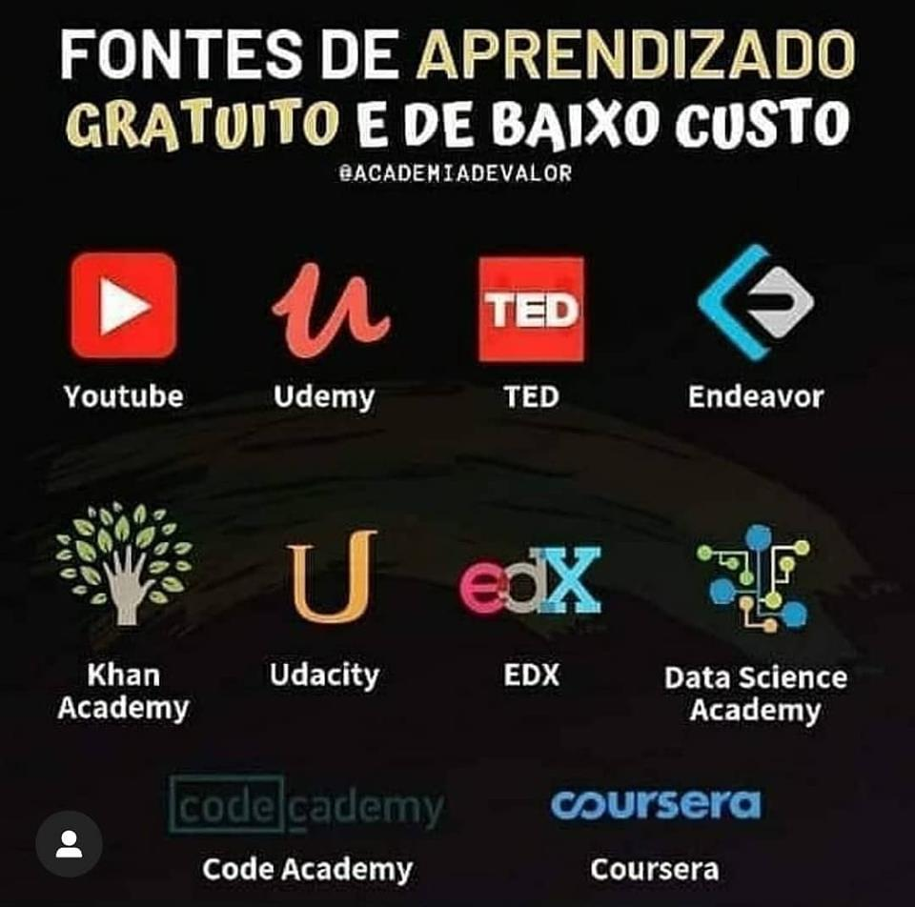

Slide 21
< SAP >
< ROTATION PROGRAM >
< INTERVIEW TIPS & TRICKS >
< MACHINE LEARNING >

Slide 22
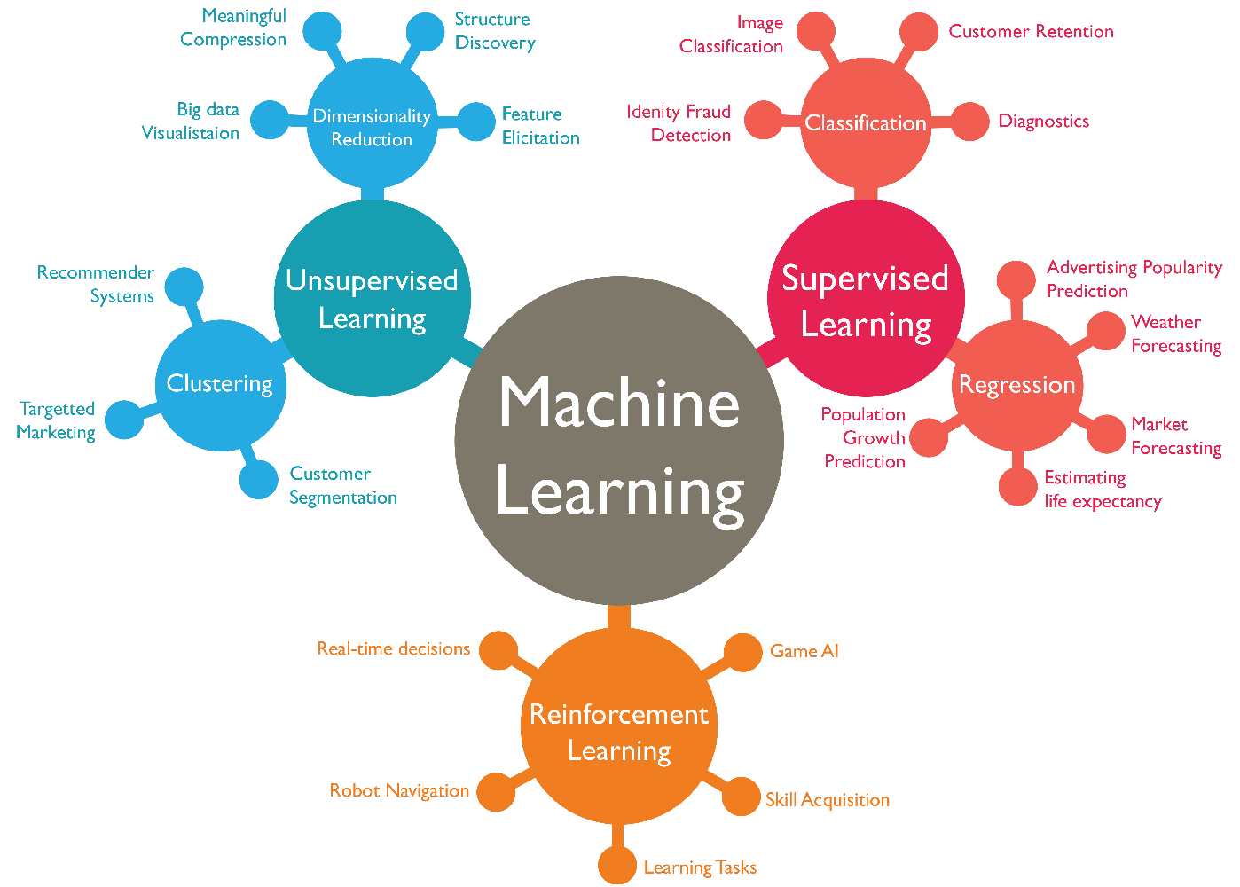

Slide 23

Classification

Slide 24
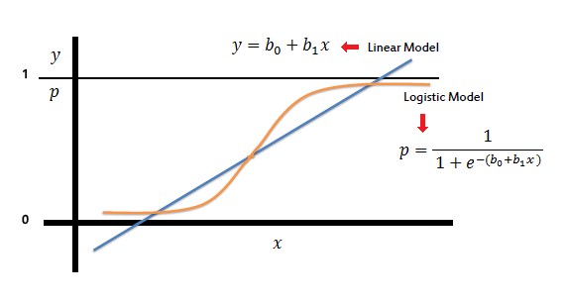
LOGISTIC REGRESSION
0 or 1
Yes or No
Spam e-mail or not
Disease Diagnosis

Slide 25
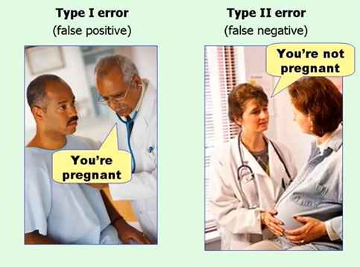

Slide 26
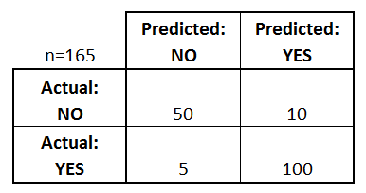
CONFUSION MATRIX

Slide 27
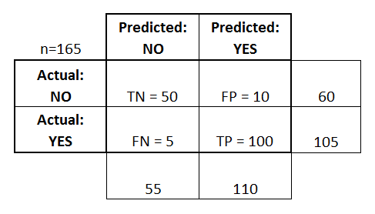
CONFUSION MATRIX

Slide 28
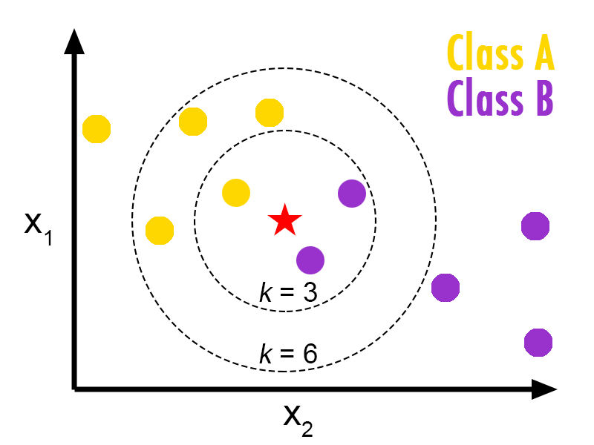
KNN - k nearest neighbor
DOG
HORSE
UNKNOWN

Slide 29
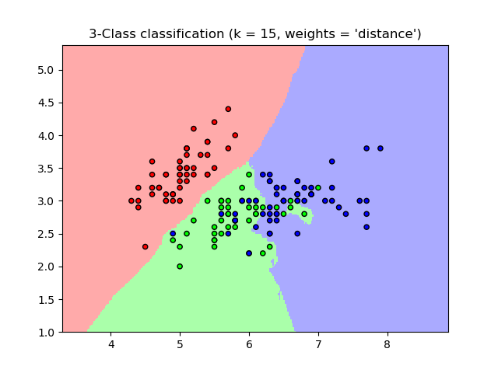
KNN - k nearest neighbor

Slide 30
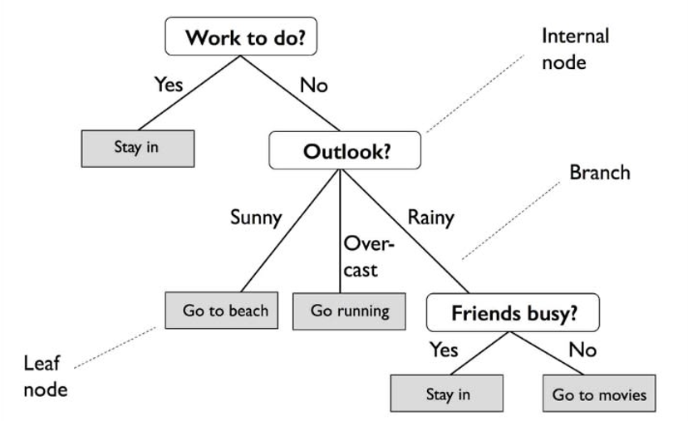
Decision trees & Random forest

Slide 31
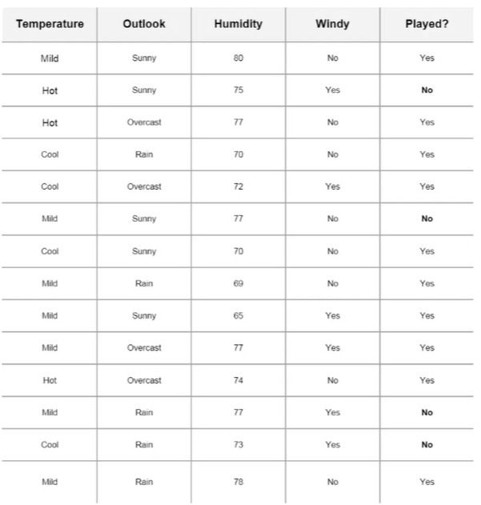
Decision trees & Random forest

Slide 32
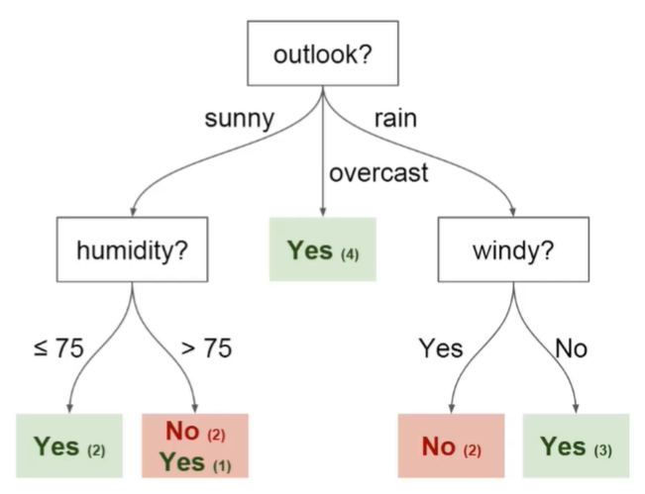
Decision trees & Random forest

Slide 33

Decision trees & Random forest

Slide 34
SVM – SUPPORT VECTOR MACHINE
Recognize Patterns
Classification
Regression Analysis

Slide 35
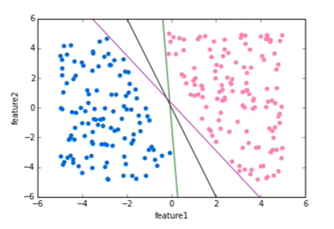
SVM – SUPPORT VECTOR MACHINE
Recognize Patterns
Classification
Regression Analysis

Slide 36
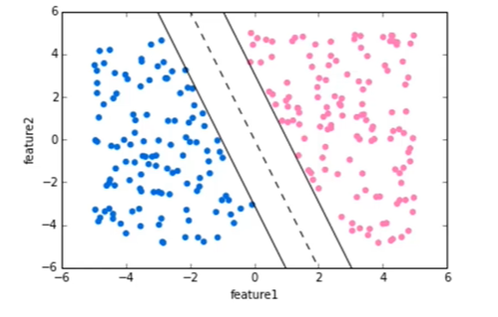
SVM – SUPPORT VECTOR MACHINE
Recognize Patterns
Classification
Regression Analysis

Slide 37
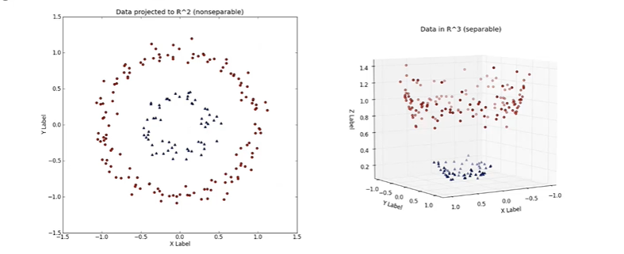
SVM – SUPPORT VECTOR MACHINE

Slide 38
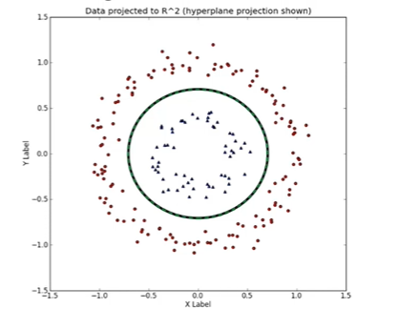
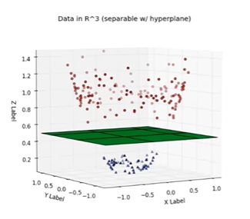
SVM – SUPPORT VECTOR MACHINE

Slide 39
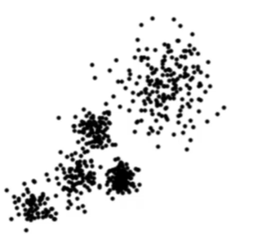
K Means clustering

Slide 40
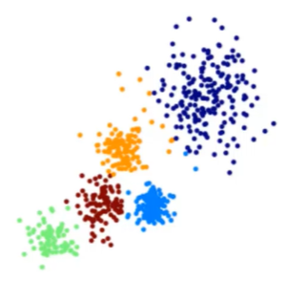
K Means clustering

Slide 41
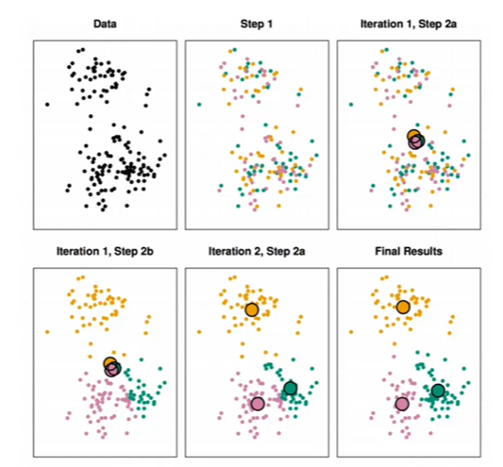
K Means clustering

Slide 42
K Means clustering

Slide 43
K Means clustering

Slide 44
K Means clustering

Slide 45
K Means clustering

Slide 46
K Means clustering

Slide 48

LET’S
CODE

Slide 49
1 - LOGIN ON GOOGLE DRIVE
2 – SEARCH FOR: GOOGLE COLAB
3 – CREATE NEW PYTHON3 NOTEBOOK

Slide 51

Henrique Padovani
padovani.h@hotmail.com
51 9 9622 3118

